Slide 1
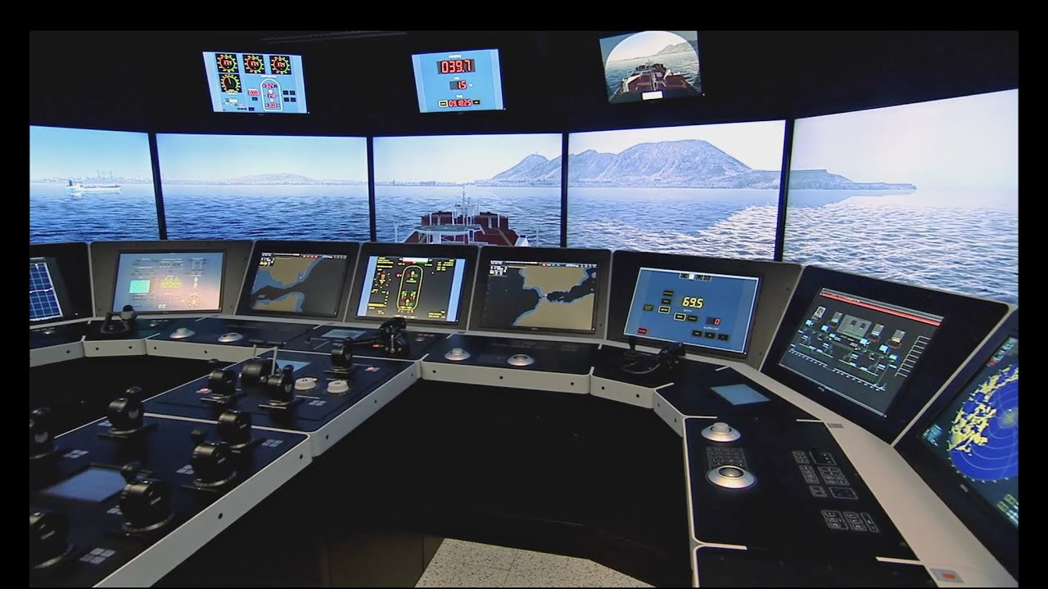

Ship Navigation
Prashani Jayasingha
Supervisor: Johan Lilius

Slide 2
Introduction
Ship Navigation communication that occurs through radio frequencies is an important part for the traffic system at sea. Any problem with regards to safety, climate, personnel is communicated through it.
The communication system consist of its own unique dialects as this gives accurate information to sea traffic.

Slide 3
Problem Statement
Clarity of information
Glitches and unwanted noise that interferes the radio communication between ships
Response & reaction time
Response and reaction time during a crisis or emergency. As well as any important information where immediate actions must be taken

Slide 4
Objective
Use machine learning algorithms to automate speech and set of a chain of actions required within the ship that resolves the problem with minimum human intervention.

Slide 5
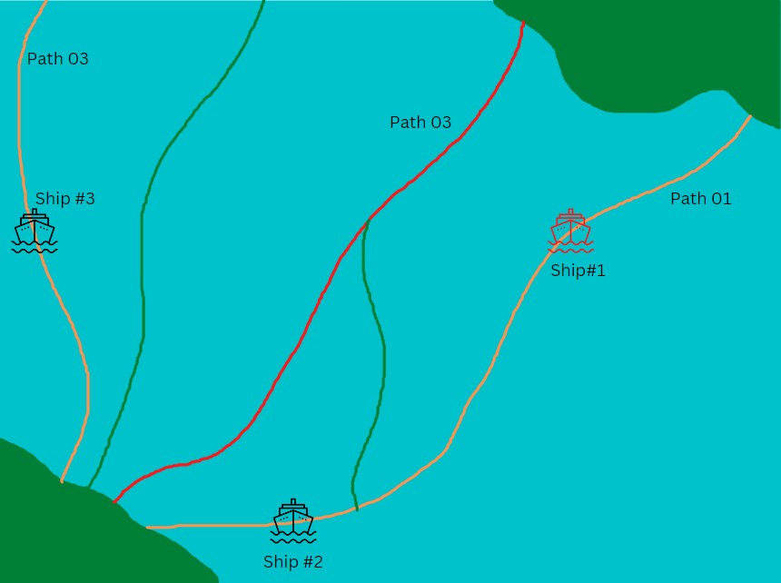
Tasks
Test case #01
Consider the following example: There is a ship that has stopped due to an emergency. This message is sent to all other ships and a decision needs to made if the message is irrelevant or if relevant, what actions need to be performed
Ship 2 has to find another path or stop moving
Ship 3 does not require this information so it should be disregarded

Slide 6
Implementations
Solution #01
Creation of a chatbot using RASA
Why?
Specific dialect gives specific sentence combinations
Simple yet fast
Contains an action file that allows external actions to be connected to the conversation

